Slide 1

Introduction to
Broken Ministries

Slide 2
What is Broken Ministries
Broken ministries is a set of lay ministries that seek to meet the needs of the broken people from our own contexts with hope and intent that God would encounter them personally in their brokenness and make them followers of Christ.
We:
Are a set of lay ministries to serve the local churches and its pastors.
Will focus on our own contexts and build a generation of lay leaders with compassion toward the broken
Will form communities of acceptance and a place to learn about God
Will seek to individually encounter and experience God personally
and help others to do the same
Premise: God will encounter us when we come to Him humbly in our brokenness and call out to Him

Slide 3
Vision of the Broken Ministries
To love others . . . (from our own contexts)
The call is to be more compassionate and merciful toward others, just as God has been to us
Our compassion should spring from remembrance that we too were once broken people, forgiven and healed by the compassion and mercy of God -- our ministries must start from there. (We love because He loves us)
Broken Ministries is a set of lay ministries that seeks to serve the local churches and pastors over them
Each of us are to focus on those from our own contexts

Slide 4
Who are the Broken?
hurt, in pain, suffering, sick, needy, unloved, condemned, stressed, lost, abandoned, weak, poor, rejected, murderer, divorced, abused, cursed, sinner, angry, tired, jobless, financially burdened, gay, immigrant, unaccepted, social outcast, confused, imperfect, flawed, everyone.
We are all broken. Yet, some of us have found acceptance and healing through Christ.

Slide 5
Why we love others
As for you, you were dead in your transgressions and sins, in which you used to live when you followed the ways of this world and of the ruler of the kingdom of the air, the spirit who is now at work in those who are disobedient. All of us also lived among them at one time, gratifying the cravings of our sinful nature and following its desires and thoughts. Like the rest, we were by nature objects of wrath. But because of his great love for us, God, who is rich in mercy, made us alive with Christ even when we were dead in transgressions—it is by grace you have been saved.
-Ephesians 2:1-5, NIV

Slide 6
Why is it called Broken
To remember our roots – that we were once broken people
So that we may show the compassion and mercy we have received toward others, especially those of our own context (people whose struggles we can relate to)

Slide 7
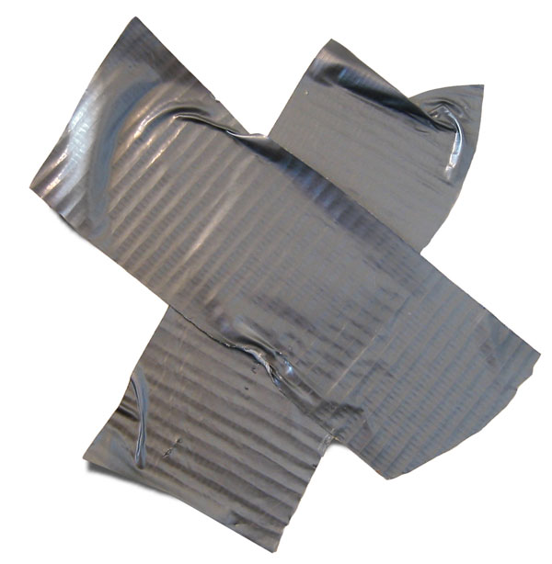
What is the meaning of the logo
God created each of us with a purpose. However, due to the effects of the world, we’re unable to be who we are made to be.
The logo shows duct tape that has been covered with mold, dirt, and other impurities. It is losing stickiness (its core purpose) and is becoming tainted to a point that it is no longer useful. However, Jesus claims us by the mercy of His cross and calls us His. He gathers us and restores us.
The heart represents the community of the broken He formed through the cross. Because of what He’s done, we are now the community of restored people that has been healed by His amazing grace.

Slide 8
















Structure of Broken Ministries
Pastor B
Pastor A
2
1
4
3
5
6
Pictures from http://www.how-to-draw-funny-cartoons.com

Slide 9
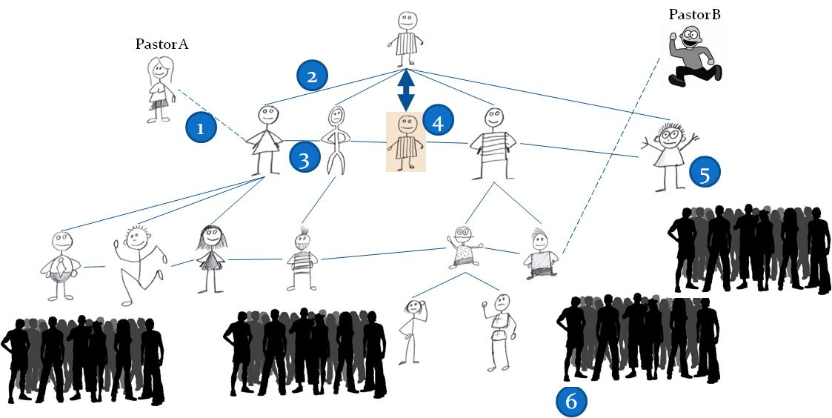
Structure of Broken Ministries
1. As a set of lay ministries, we must absolutely honor and follow our pastors (many of us may come from other churches)
2. There should be a general leader for a small number of people. This group should focus on a general purpose.
3. Each group should have a heart of community, having high respect and love for each other. Open communication and ability to communicate is an absolute must.
4. Every general leader should, for the most part, be a peer and minister as God calls them. (That is, even if the general leader is missing, the team should be able to continue without loss). The goal is not to be a leader, but a servant to others. Members of Broken Ministries will focus on people from their own contexts while they strive to serve the local churches and its pastors.
5. One should develop their ministry in his/her own context as God leads him/her. One may start alone, but eventually find others with the same heart and further develop the ministry.
6. As new members come, they may not know where to insert themselves, or if they want to get involved at all. Give them time and assimilate into our community and love them as they are. When ready, they can join existing ministries or start new ones as God prompts them. Help them to fit in and be part of the community.

Slide 10
Functions of a Small (Peer) Group
Mini-church – gathers to perform at a minimum these three things
  Worship (meet with the transcendent God)
  Prayer (bring up our requests to the Father)
  Come together (form/foster community)
  (These are the rights of a Christian and a Church, so let’s do it boldly!)
Plan and develop the ministry toward the people of your context (it should aim to be a standalone ministry)
  Eg. High school guys, Korean-speaking immigrants, People struggling through difficult economy, etc

Slide 11
Character of General Leaders
-Characteristics of a leader
-- One who loves God
(has received the compassion of Jesus)
-- One who loves others
(desires to be compassionate toward others from the compassion he has received)
Each member should seek to lead small (peer) groups as we continue to grow:
- This requires us to seek holiness, attractive lifestyle

Slide 12
Why a Ministry of Lay People?
Lay people are better situated to reach the lost than pastors because:
Insertion to non-Christian contexts
Some financially capable to provide for needs
It is a role of a Christian, not of a pastor, to make disciples of all nation (pastors’ roles are to equip the Christians to go forth and fulfill the Commission)

Slide 13
Where are we going? (Long-run)
Three directions
1. Building Database of pastors/churches (Need to be done with collaboration with other pastors in the area)
(to seek collaboration of the local churches)
2. Building Database of the broken (Something our ministry should build together)
(to seek out/determine the needs of the people, especially within our local areas)
3. Development our organization/ministries

Slide 14
Our Initial Goal
Community (How can we build an environment where people can feel like they fit in)
  They are comfortable and feel accepted
  They are able to build long-term friendships
  They can say “you guys got my back”
  Communication is open and always viable (not just Sundays)
Your context (What kinds of people do you relate to? What are their hurts/pains/brokenness?)
  Consider your own brokenness. What kinds of experiences have you gone through that allows you to relate to others? From what has God healed you?

Slide 15
First Step
Build relationships, form community
  People are looking for reliable relationships (think about it), but are often broken because
    People have often hurt them, not been reliable, been selfish
    They look for safe relationships, a place to be popular and made known – they feel rejected as the Internet cannot satisfy
    This is how our communities have broken down – now there are many individuals hurting in private, but outwardly looking ok to fit in w/ society)
How can we now rebuild this broken community?
How can we improve our own relationships?
How can we make our constant communication work? (if we can’t be a community ourselves, how can we expect others to join us to take part in this community?)
(For Christians) How can we strive to live a faithful, attractive lifestyle?

Slide 16
How did this ministry come about?
Logic doesn’t lead to faith. There is no evidence great enough to cause faith – only an encounter with, an experience of God can bring us to repentance
When we meet the Holy God, he exposes us of our sins; then he restores us, heals us, and changes our lives to be people of faith
It’s through our surrender of our brokenness that God can enter and work in us.
With this compassion, we ought to go forth into the world and love others
Only you can connect to those of your own contexts!
Pastors have the roles to equip people to do ministry; the lay people have roles to bring people to Christ

Slide 17
Communion
We welcome everyone into the family of God regardless of one’s past, wrongs, or failures.
(That’s what Jesus does for us)
Before Jesus took up the cross to die for our sins, he broke bread and shared wine to signify unity through communion.
We are one
Through the body of Christ (symbolized by the bread)
Through forgiveness of sins through His blood (wine)

Slide 18
Notes
As a starting ministry, we do not have a Lord’s Day (Traditional Sunday) service. We plan to start a Lord's Day service eventually for those that do not attend another church, but the goal is to develop this ministry before looking into starting a formal service.

Slide 19
Extra Contents

Slide 20
Mindset of a Fisherman
Hunters go after certain people/groups and shoots and leaves.
Street Evangelism
Just our group of friends
Come believe in Jesus because I DO! just doesn't cut it.
Fishermen wait patiently,
They have the mindset that when the fish desire to be caught, they will come.
Fishermen are well aware of their pond and the kinds of things the fishes go through
(This requires study and insertion into the contexts of the people)
Fishermen use the right baits for the right fish, so that they can come when ready
(This requires a holy, attractive lifestyle to make this possible)
  So, if you tell people to come to church, but you curse people, hurt them, offend them in your daily lives, there's very little chance you'll catch fish.
  When in times of crises, can people depend on you? Are you trustworthy? Reliable? A person of God (at least in their eyes?)
People may not claim to seek God regularly, but as crises happen in their lives, they are looking for a solution, an answer to their life’s problems. When they do, let’s be ready to welcome them into our community, showing acceptance, and a chance for God to work in their lives.

Slide 21
Examples of Ministries for Social Justice
At-risk youths (http://www.breakawayoutreach.com)
Human Trafficking (http://www.love146.org)
Prison Ministries (http://www.prisonfellowship.org)
Hungry/Starving Children (http://www.compassion.org)
We should always strive to support these missions, but our primary goal should be those of our own contexts

Slide 22
Extra notes:
Goal: Focus on where you are in life -- find compassion toward that group and grow from there
--Come up with a prayer chart -- where believers can pray for the city/neighbors; while not-yet-believers can pray for or ask about God and converse with God

